Slide 1
Basic Details of the Team and Problem Statement
Ministry/Organization Name/Student Innovation:
AICTE, MIC-Student Innovation
PS Code: SIH1484
Problem Statement Title: Counterfeit Identifier Through Blockchain
Team Name: The Blockchain Developers
Team Leader Name: B. Mahi Sai Sujan
Institute Code (AISHE): U-0957
Institute Name: Centurion University of Technology And Management
Theme Name: Blockchain & Cyber Security

Slide 2
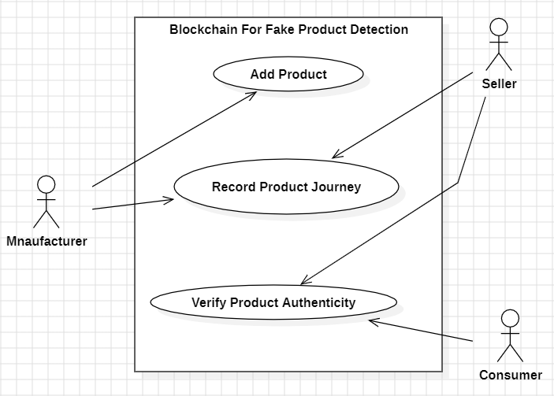
Idea/Approach Details
Describe your idea/Solution/Prototype here:
The project aims to counterfeit identifier through BlockChain.
It combines advanced technologies : Etherum BlockChain, Html, Css, JavaScripit, solidity, MetaMask .
The goal is to detect fake products using blockchain technology.
The system uses algorithms to analyze images and videos, predict quality, identify damages, and integrate real-time sensor data.
This approach is to detecting fake products using BlockChain technology is an innovative promising approach as blockchain provides a secure and immutable ledger that can be used to verify the authenticity and provenance of products.
Describe your Technology stack here:
Solidity
Visual Studio
Truffle Suite
Ganache
Meta Mask
Node.js
Web3.js

Slide 3
Idea/Approach Details
Benefits
Show stopper
Improved Consumer Safety: Consumers can confidently purchase genuine products, knowing that they are protected from counterfeit and potentially dangerous goods.
Brand Protection: Companies can safeguard their brand reputation by ensuring that only genuine products reach consumers.
Regulatory Compliance: The system aligns with regulatory requirements for product tracking and tracing.
Reduced Counterfeiting: As counterfeiters face greater challenges in producing fake products, the prevalence of counterfeits in the market decreases.
Enhanced Supply Chain Efficiency: Blockchain streamlines supply chain operations and reduces fraud and errors..
Counterfeit Serialization: If counterfeiters can obtain valid serial numbers or QR codes, they can still produce fake products that appear genuine when verified on the blockchain
Privacy Concerns: Blockchain's transparency can be a double-edged sword. While it ensures data integrity, it may expose sensitive information that needs to be protected, especially in industries like pharmaceuticals.
Limited Reach: The effectiveness of blockchain-based fake product detection relies on widespread adoption. If only a few companies or entities in the supply chain use blockchain, it may not provide comprehensive protection against counterfeits.

Slide 4
Problem Statement Canvas
PROBLEM STATEMENT:
Every popular brand has fake manufacturers selling a counterfeit item with misleading and invalid labels, which are sold at cheaper rates. Even the company experts may not be able to distinguish between counterfeit and original items.
CONTEXT:
Fake product identification using BlockChain technology is a context where blockchain is employed to verify and authenticity the authenticity of products counterfeit is prevasive problem in various sectors leads to significant risks.
ALTERNATIVES:
Generally customers detect product manually this process relies on human senses, expertise, and judgment when process is done by block chain involves automated data collection through sensors data is recorded on a blockchain ledger . Human intervention is minimal during detection process as blockchain detects and records the data automatically.
USERS:
The customers who purchase the product whether it is fake customer get loss by purchasing it so by using blockchain by scanning the product it detects and notice whether the product is fake or orginal by this the fraud of selling fake products will be reduced.
SHORTCOMINGS:
Without expertise it can be challenging to accurately identify fake items.
Detecting the products manually can be time consuming especially if the process involves detailed examination or testing.
Subjective:manual inspection is inherently subjective and prone to human error.
The manual process does not utilize advanced technologies.
QUANTIFIABLE IMPACT:
Average time taken to get results by manually product detection .
Customer satisfaction ratings related to generating the results of detecting the product..

Slide 5
Team Member Details
Team Leader Name: B Mahi Sai Sujan
Branch (Btech/Mtech/PhD etc):Btech Stream (ECE, CSE etc):CSE Year (I,II,III,IV): III
Team Member 1 Name: P Sunanditha
Branch (Btech/Mtech/PhD etc):Btech Stream (ECE, CSE etc):CSE Year (I,II,III,IV): III
Team Member 2 Name: P Sri Lakshmi
Branch (Btech/Mtech/PhD etc):Btech Stream (ECE, CSE etc):CSE Year (I,II,III,IV):III
Team Member 3 Name: T Satheesh
Branch (Btech/Mtech/PhD etc):Btech Stream (ECE, CSE etc):CSE Year (I,II,III,IV):III
Team Member 4 Name: M Abhishek
Branch (Btech/Mtech/PhD etc):Btech Stream (ECE, CSE etc):CSE Year (I,II,III,IV): III
Team Member 4 Name: V Harshith
Branch (Btech/Mtech/PhD etc):Btech Stream (ECE, CSE etc):CSE Year (I,II,III,IV): III
Team Mentor 1 Name: Mr Siddarath
Category (Academic/Industry): Academic Expertise (AI/ML/Blockchain etc): Blockchain Domain Experience (in years):
Team Mentor 2 Name: Mr Nirvan Abhilash
Category (Academic/Industry):Academic Expertise (AI/ML/Blockchain etc): Blockchain Domain Experience (in years):

